Slide 1
Comparative Analysis of Two-View and Three-View Pose Estimation Algorithms for Image-Based 3D Reconstruction
Fundamental Matrix vs Trifocal Tensor
Giovanni Versiglioni

Slide 2
Outline
The Fundamental Matrix
The Trifocal Tensor
Pose Estimation
Experiments

Slide 3
1. The Fundamental Matrix

Slide 4
1. The Fundamental Matrix
Definition
Linear computation with the Normalized Eight Point Algorithm
Given at least 8 point correspondences
Transform coordinates in normalized space (with normalizing matrix T)
Determine normalized FM using Af = 0 system of linear equations
Apply SVD to normalized FM (in order to have null determinant)
Transform obtained matrix back to original space
Optimized Gauss-Helmert Algorithm
Given at least 8 point correspondences, find initial linear estimate with Normalized Eight Point Algorithm
Apply Gauss-Helmert to iteratively reduce estimation error

Slide 5
2. The Trifocal Tensor

Slide 6
2. The Trifocal Tensor
Parametrizations:
Ressl Constraints on the correlations slices. 20 parameters, 2 constraints.
Nordberg Three 3x3 orthogonal matrices, transforming original tensor to sparse one with 10 non-zero parameters.
Faugeras and Papadopoulo 12 constraints (3 third-degree, 9 sixth-degree).
Ponce and Hebert Three matrices, derived from intersection of three lines in space, impose constraints on the correspondence among three image points. 6 homogenous constraints.
Optimized Gauss-Helmert Algorithm
Find initial linear estimate with Algebraic Minimization Algorithm
Apply Gauss-Helmert with respect to the considered parametrizations to iteratively reduce estimation error
Derivation and Definition
Trilinearities
Linear computation with the Algebraic Minimization Algorithm
Given set of point/line correspondences
Compute At = 0 system of linear equations, and solve using least squares to find initial estimate
Find epipoles e21 and e31 as common perpendicular to left-null vectors of the tensor’s slices
Build matrix E s.t. t = Ea, and find t (27-vector made up of TFT entries)
Iteratively apply least squares with Levenberg-Marquardt to improve (and eventually find the optimal) epipoles pair e21 and e31 (step 3)

Slide 7
3. Pose Estimation

Slide 8
3. Pose Estimation
Method to extract camera poses either from the trifocal tensor or from the fundamental matrices:
Given a trifocal tensor, derive the epipoles (projection of first camera center onto second and third images)
Compute the fundamental matrices
Derive the essential matrices (and the calibration matrices)
Derive the camera orientations (rotation + translation) via SVD of the essential matrices
Apply Bundle Adjustment to refine the orientations, by minimizing the square reprojection error

Slide 9
4. Experiments

Slide 10
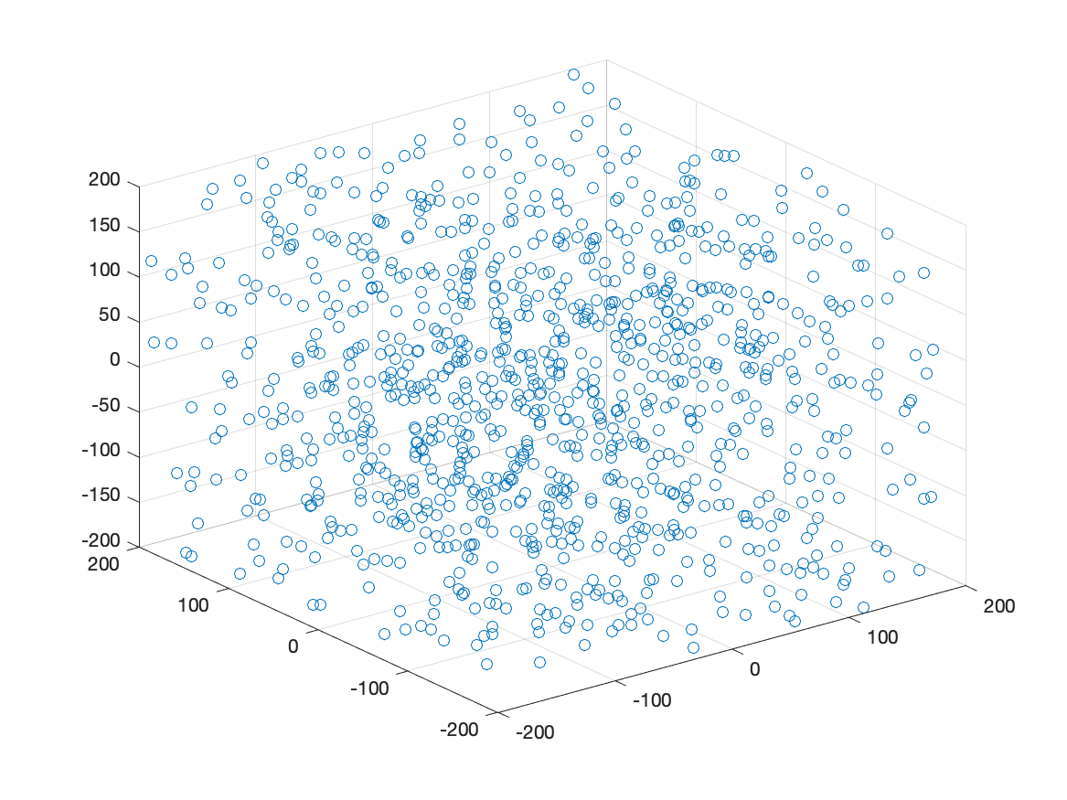
4. Experiments: Synthetic Data
Initial setup:
Spatial points within a 400mm-sided cube, projected onto three views
Gaussian noise with 1px standard deviation
50mm focal length
Null angle among camera centres
1800x1200 pixels image, meaning 36x24 mm sensor size
Simulations before and after Bundle Adjustment:
Varying Gaussian noise standard deviation
Varying focal length
Varying number of points
Varying angle among camera centers
Results in Report

Slide 11
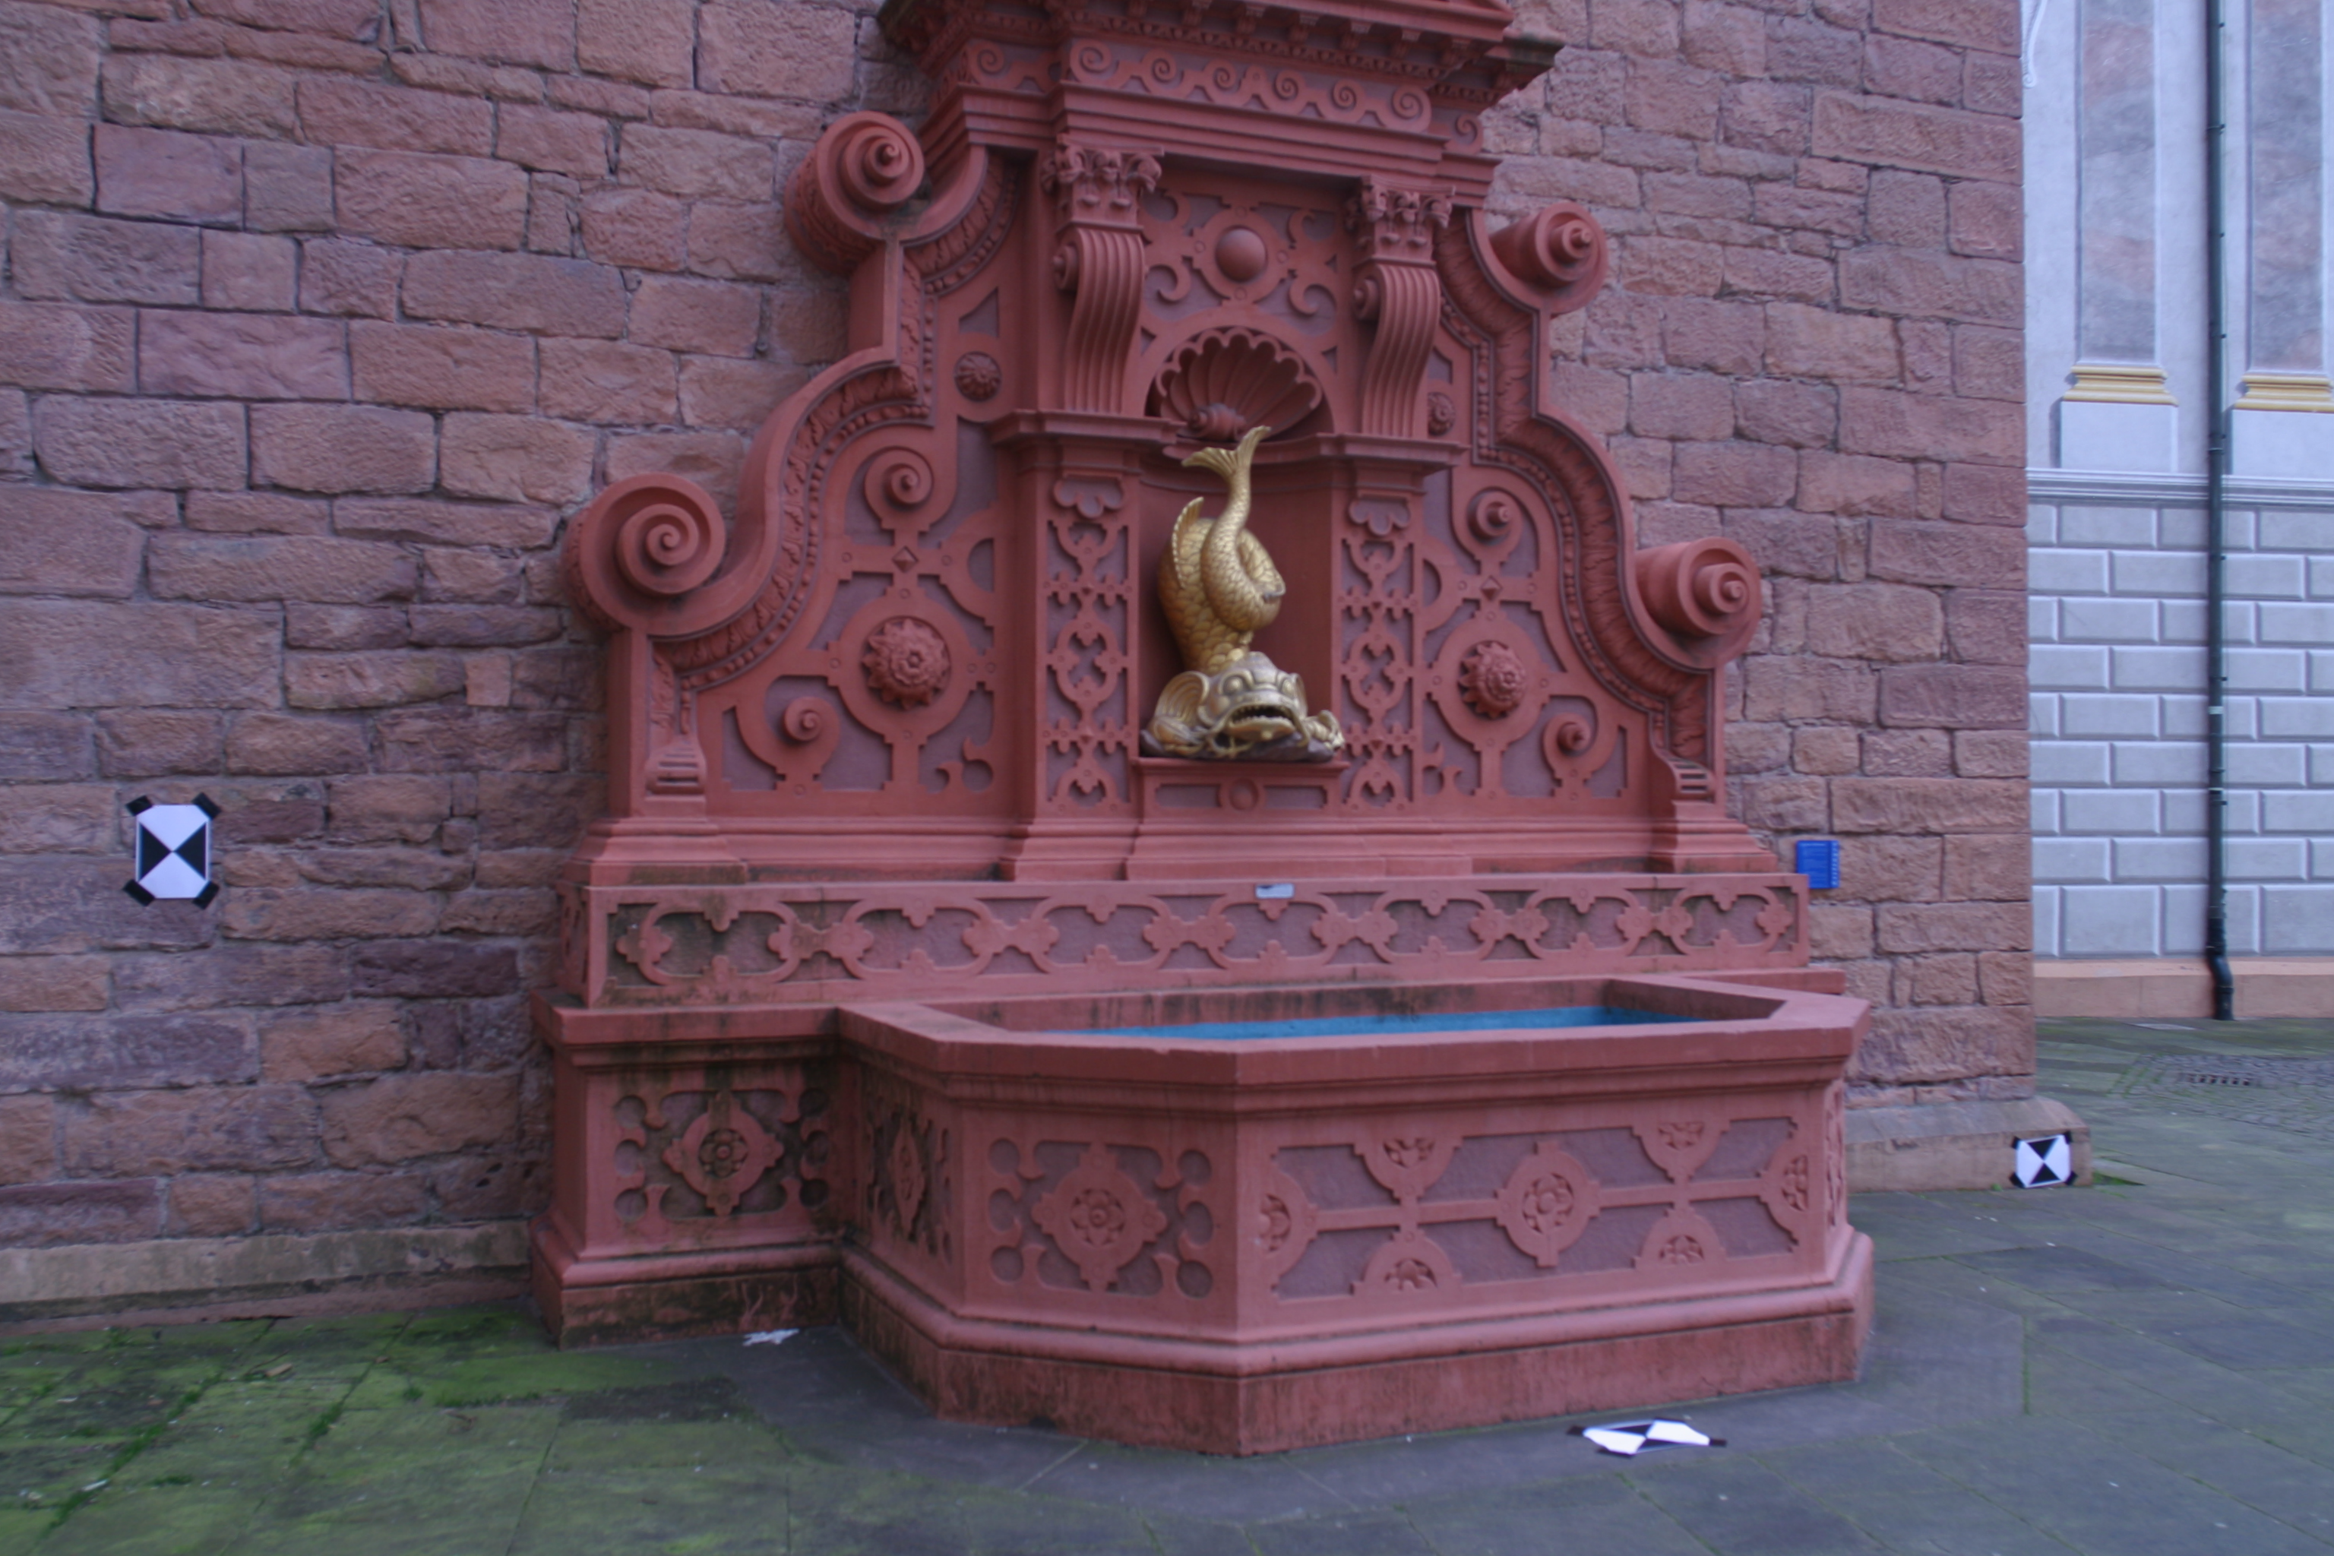
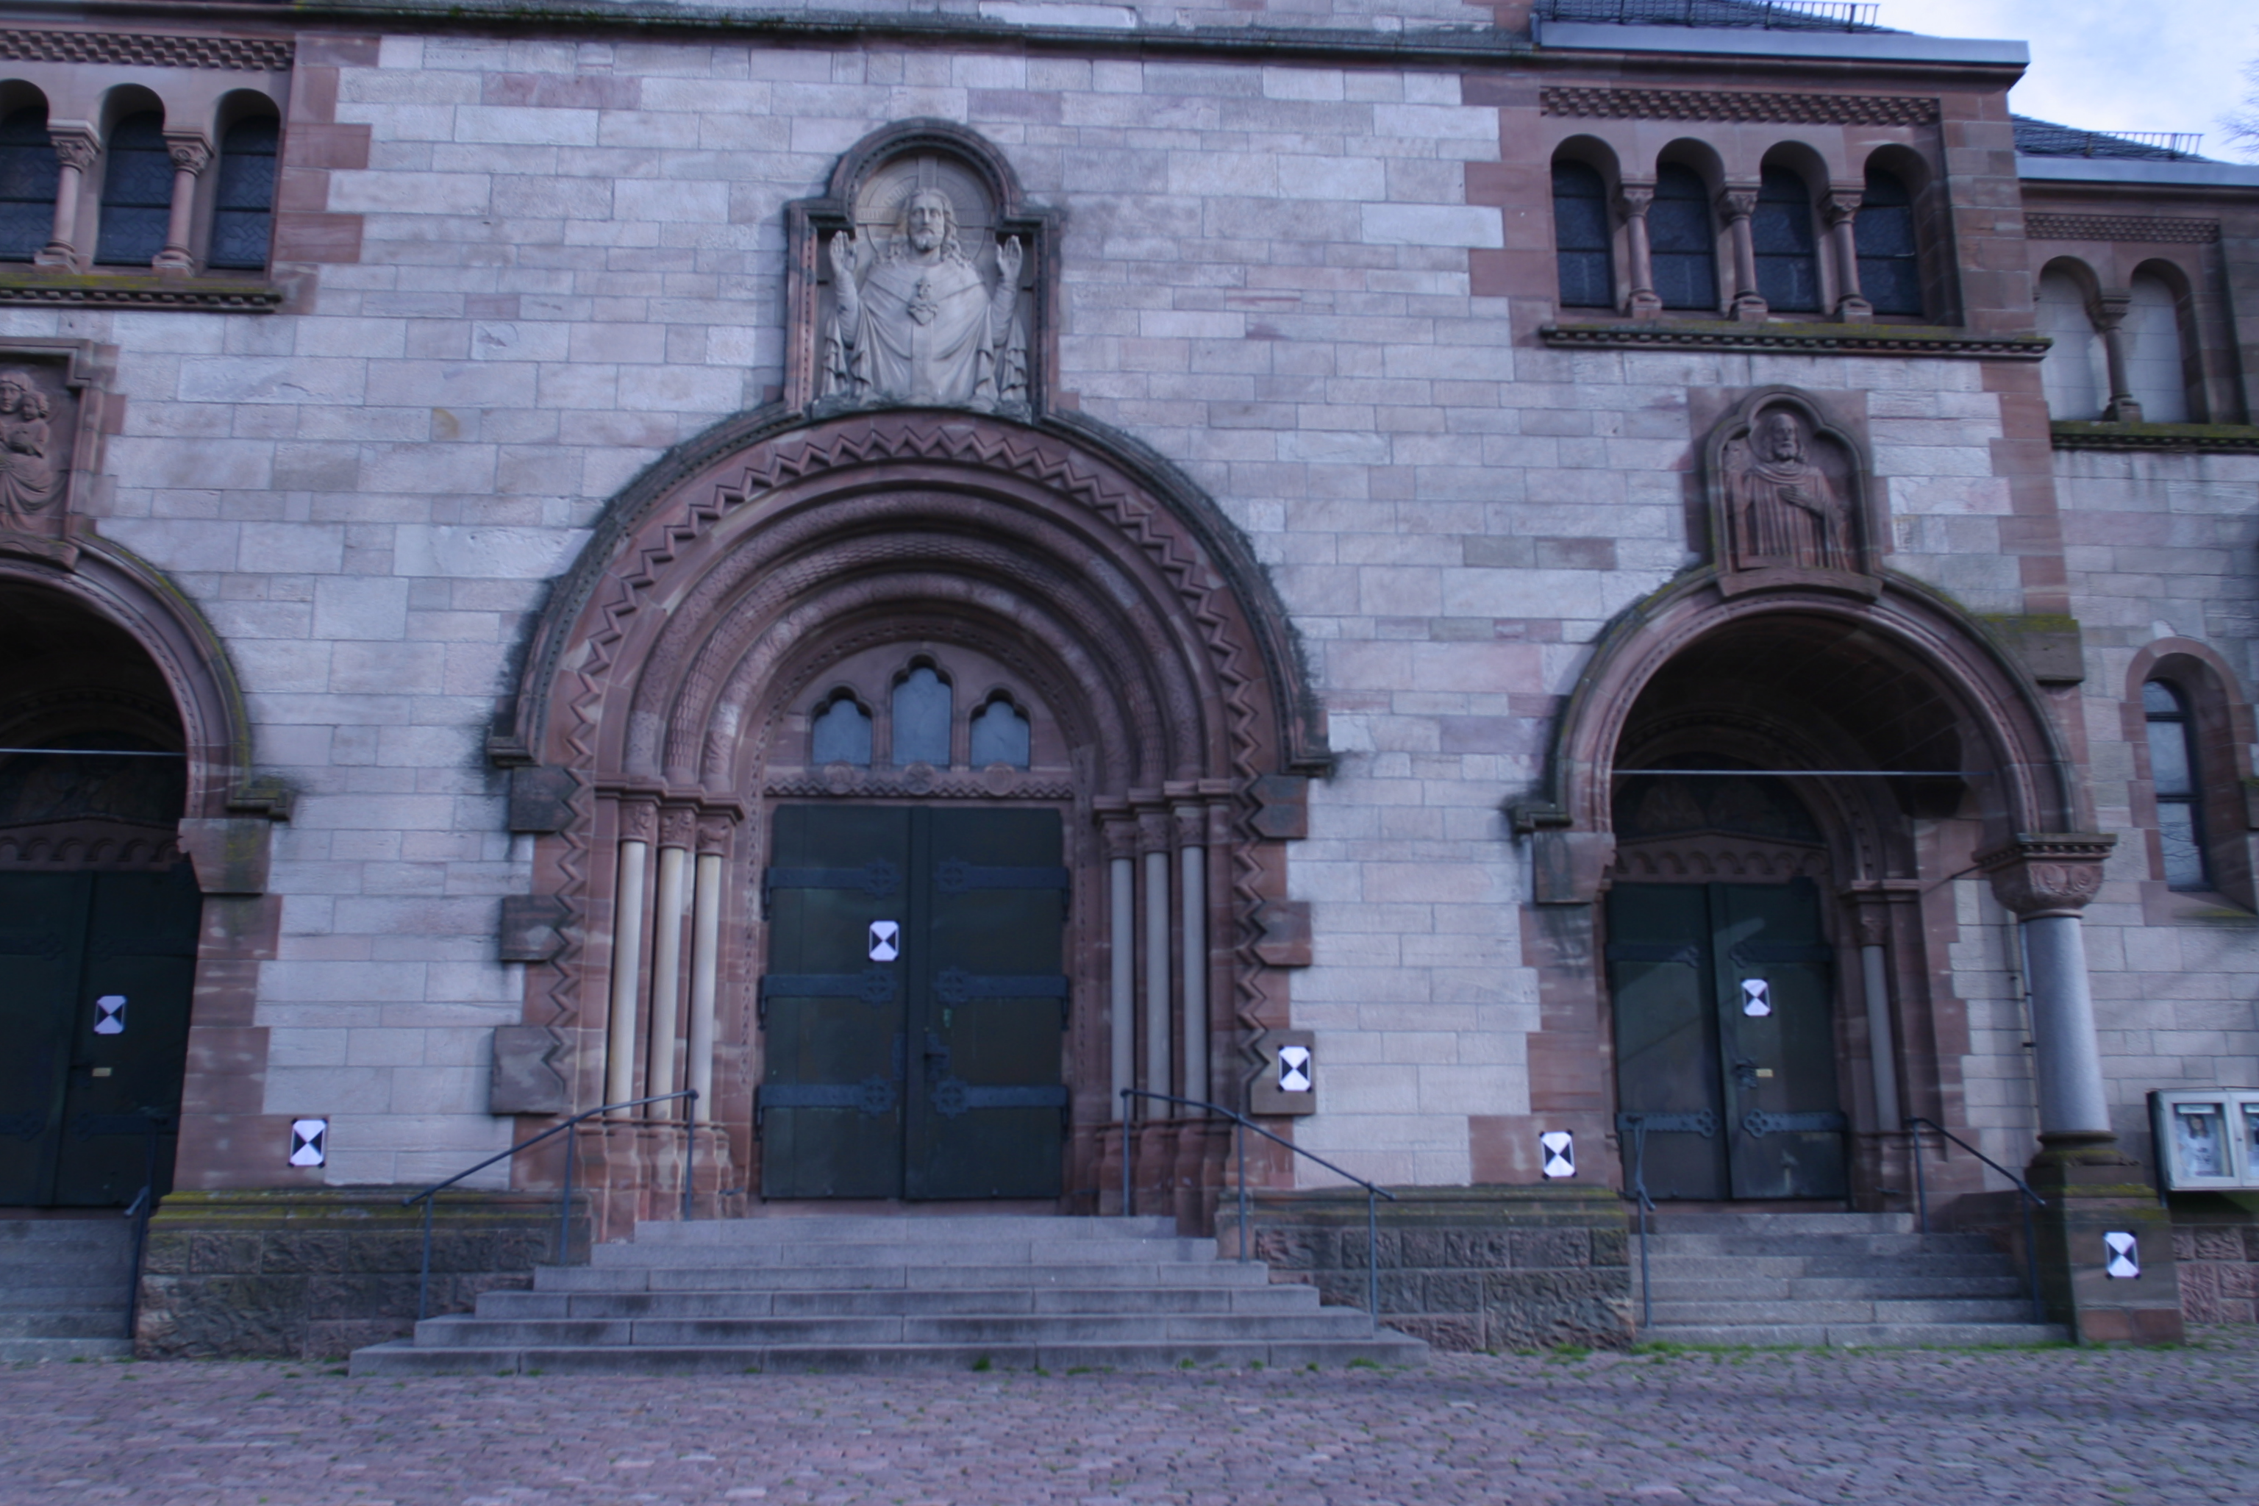
4. Experiments: Real Data
Triplets of images from “fountain-P11” and “Herz-Jesu-P8” of the given EPFL Dense Multi-View Stereo Dataset
Method Outline:
Iterate through triplets, extracting point correspondences
Compute metrics for each method considered (FM, TFT parametrizations)

Slide 12
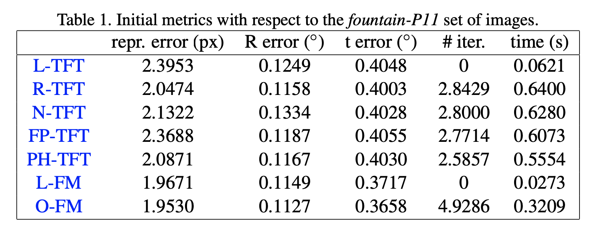
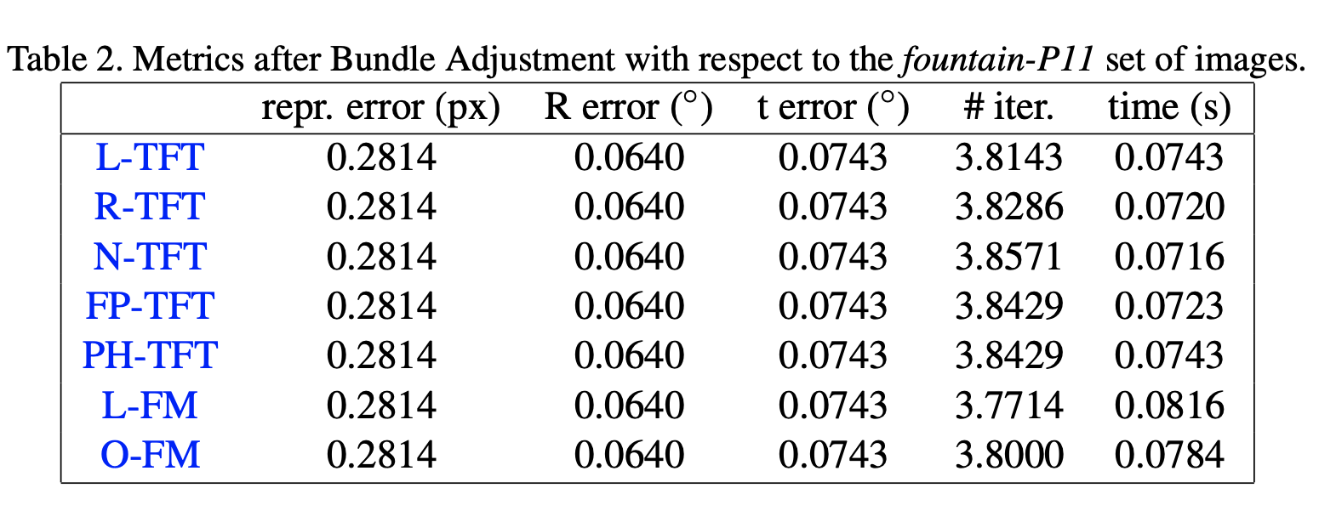
4. Experiments: Real Data: Results (fountain-P11)

Slide 13
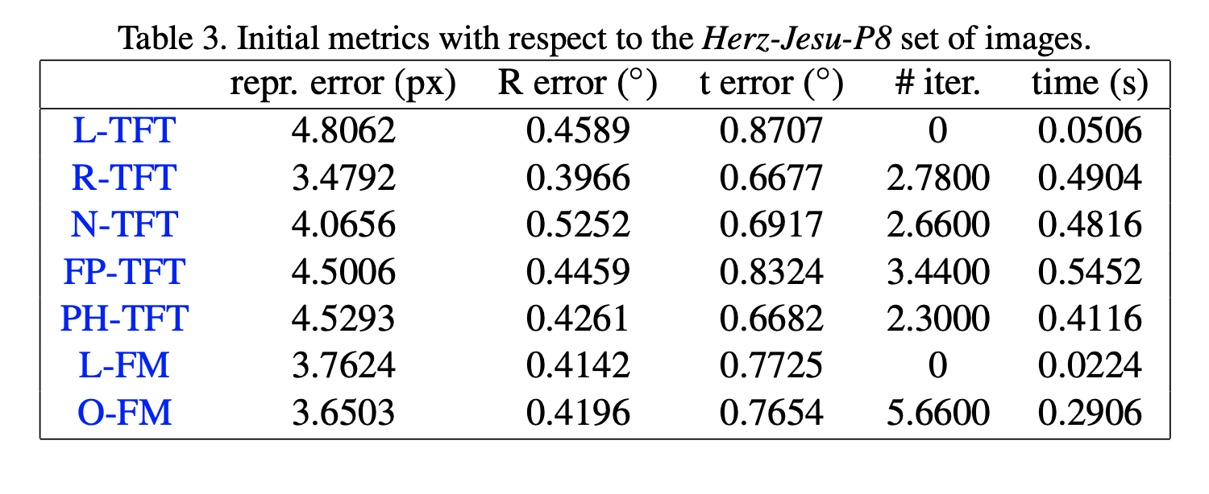
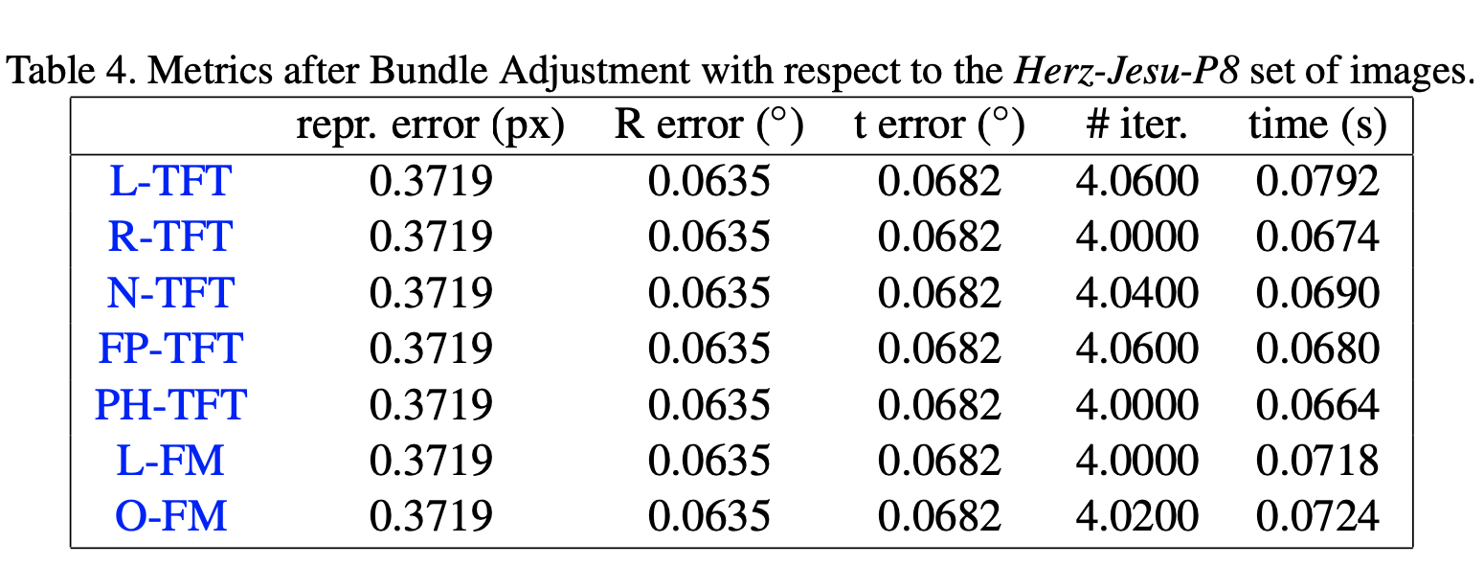
4. Experiments: Real Data: Results (Herz-Jesu-P8)

Slide 14
5. Conclusions

Slide 15
5. Conclusions
Bundle Adjustment has a major influence on the performances with respect to the different mathematical structures considered
However, without BA, TFT metrics are (in general) slightly better than FM metrics
But, not that significantly to consider the TFT a better solutions over the FM, also considering that the FM is a much simpler and more intuitive mathematical structure

